Slide 1



Paradise + GovWell
Onsite Evaluations
Paradise, CA | June 2025

Slide 2
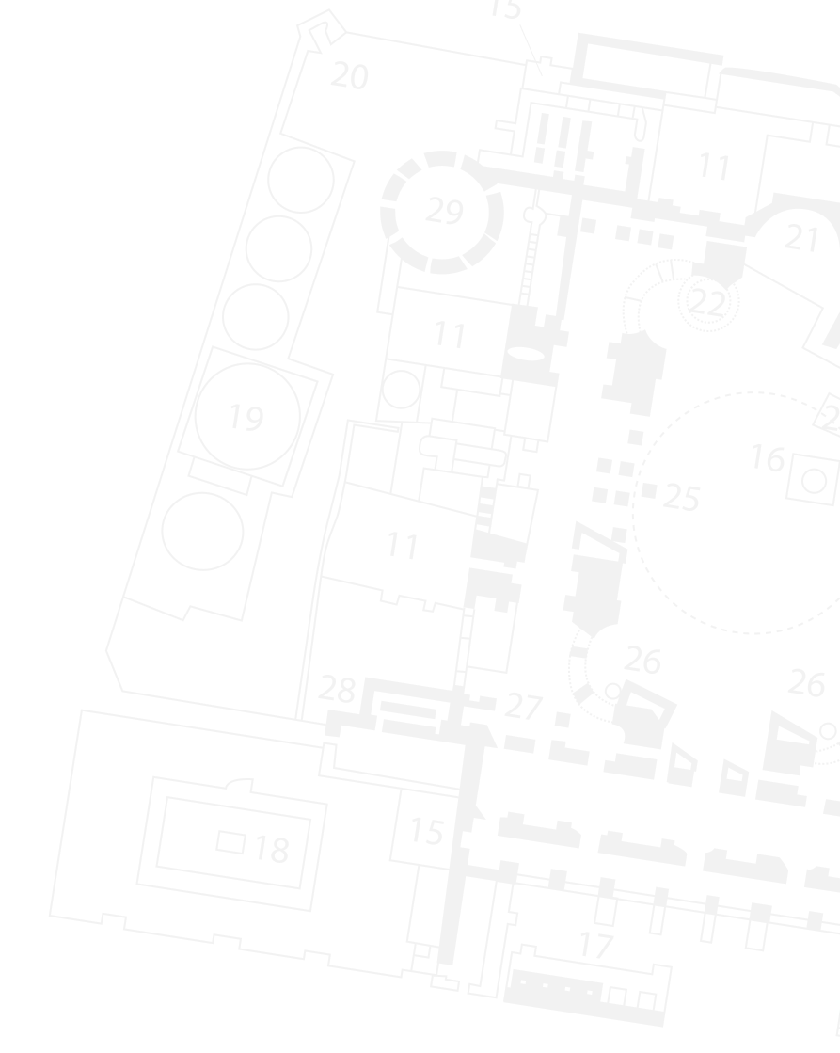
Review
Signing Up for GovWell
Submitting an Evaluation Request
Submitting an Evaluation

Slide 3
Signing Up for GovWell

Slide 4
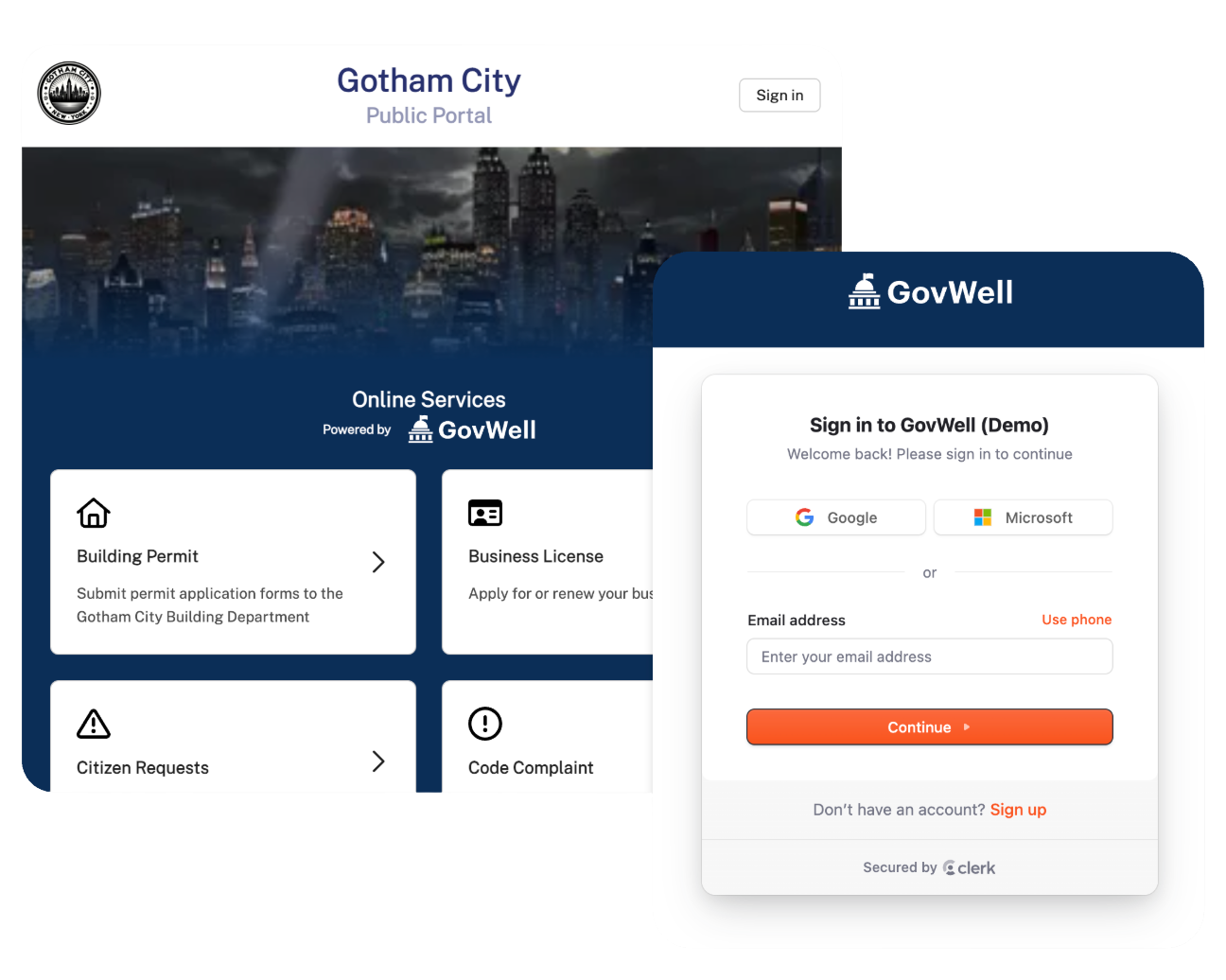
Signing Up for GovWell
You will click “Sign In” to be brought to the Sign-Up Page
After June 9th sign up for a govwell account at:
app.govwell.com/paradise
Signing up after June 9th will allow us to associate migrated records from Accela to your account

Slide 5
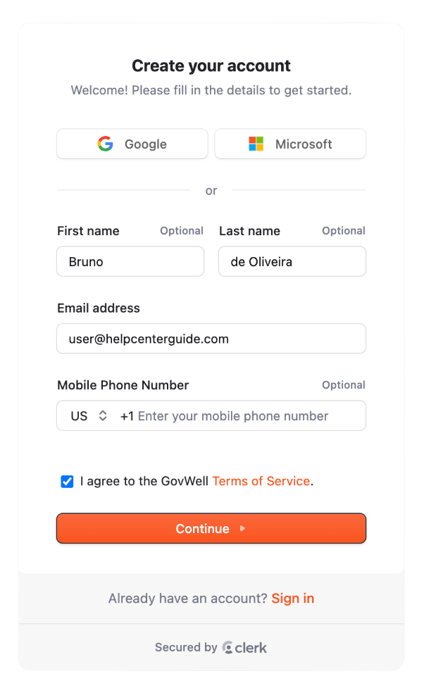
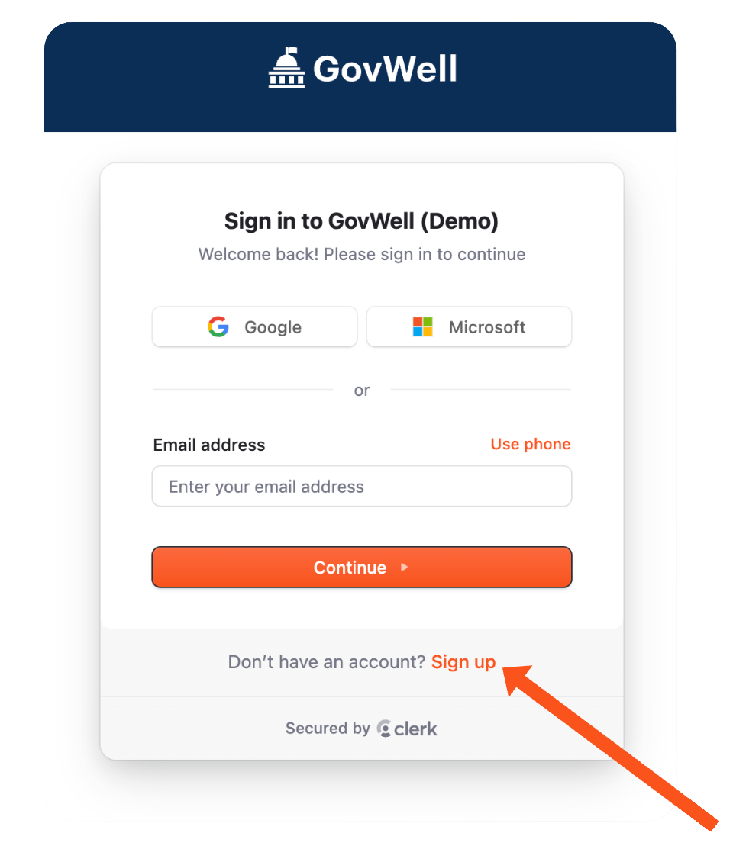
Signing Up for GovWell
After Clicking Sign-In, you can select Sign-Up to create your account
To access records that you previously created in Accela, use the same email address as your Accela account
You can then proceed to create your account

Slide 6
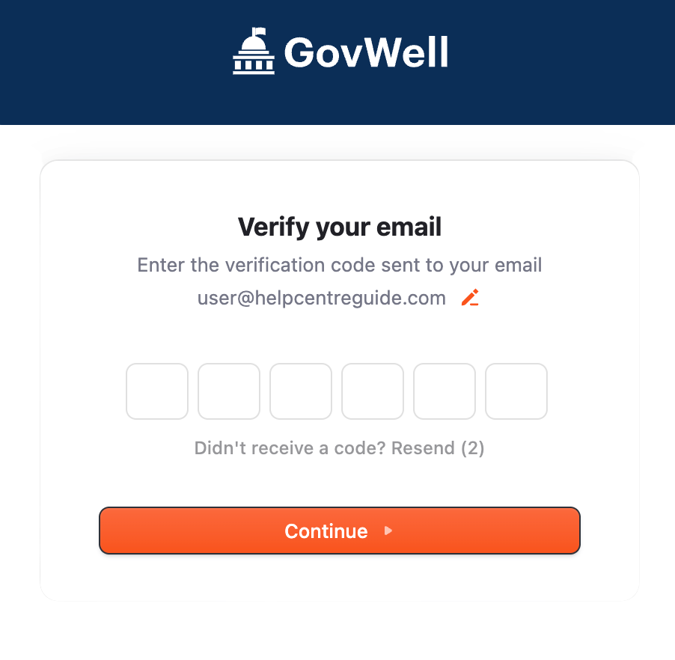
Verify Your Email
A six-digit verification code will be sent to your email inbox.
If you don’t see the email with the code, please refresh your inbox and check your spam/junk folders!

Slide 7
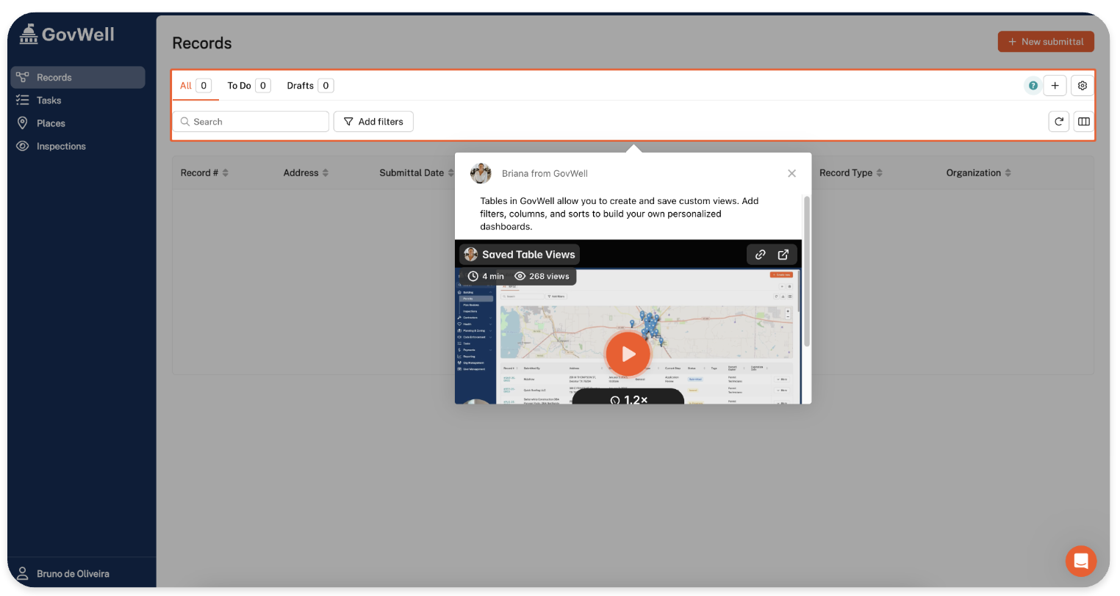
Signing Up for GovWell
Insert the six-digit code, and that's it!
You’ll be greeted by the home screen and are now ready to start using Paradise's online services!

Slide 8
Submit an Evaluation Request

Slide 9
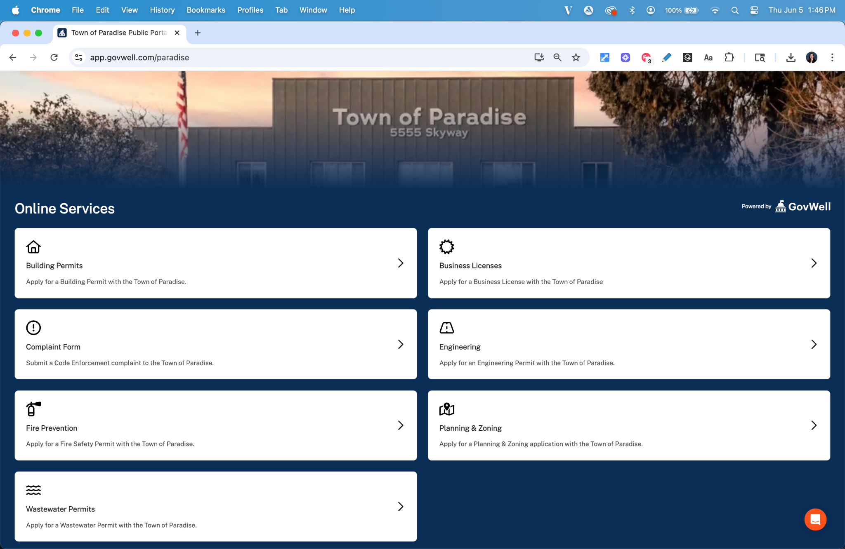
Submit an Evaluation Request
To begin an Evaluation request navigate to:
app.govwell.com/paradise
And select the Wastewater Permits module

Slide 10
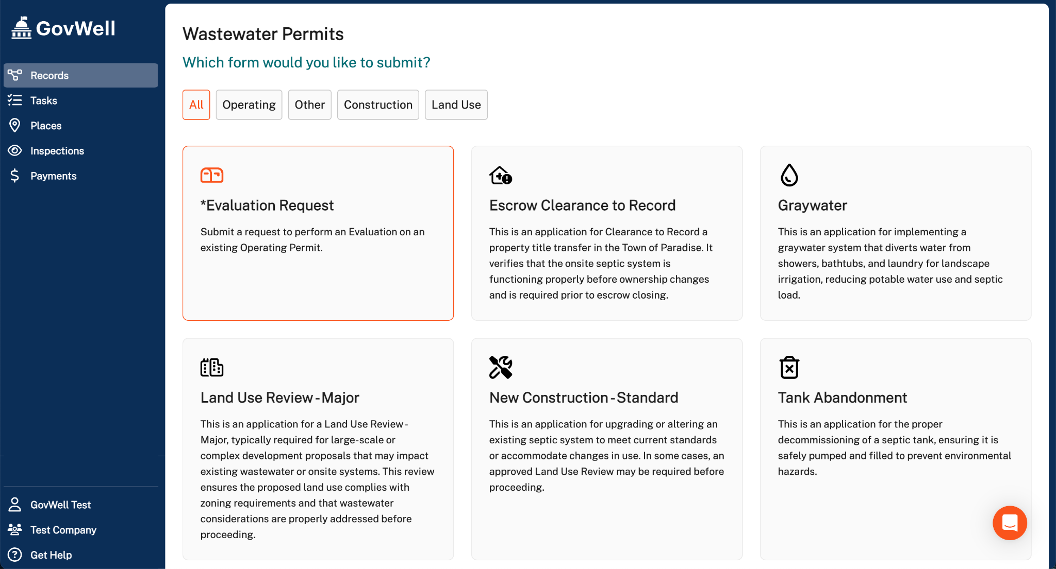
Submit an Evaluation Request
Once you are in the Wastewater Module,
you will be able to select
an Evaluation Request

Slide 11
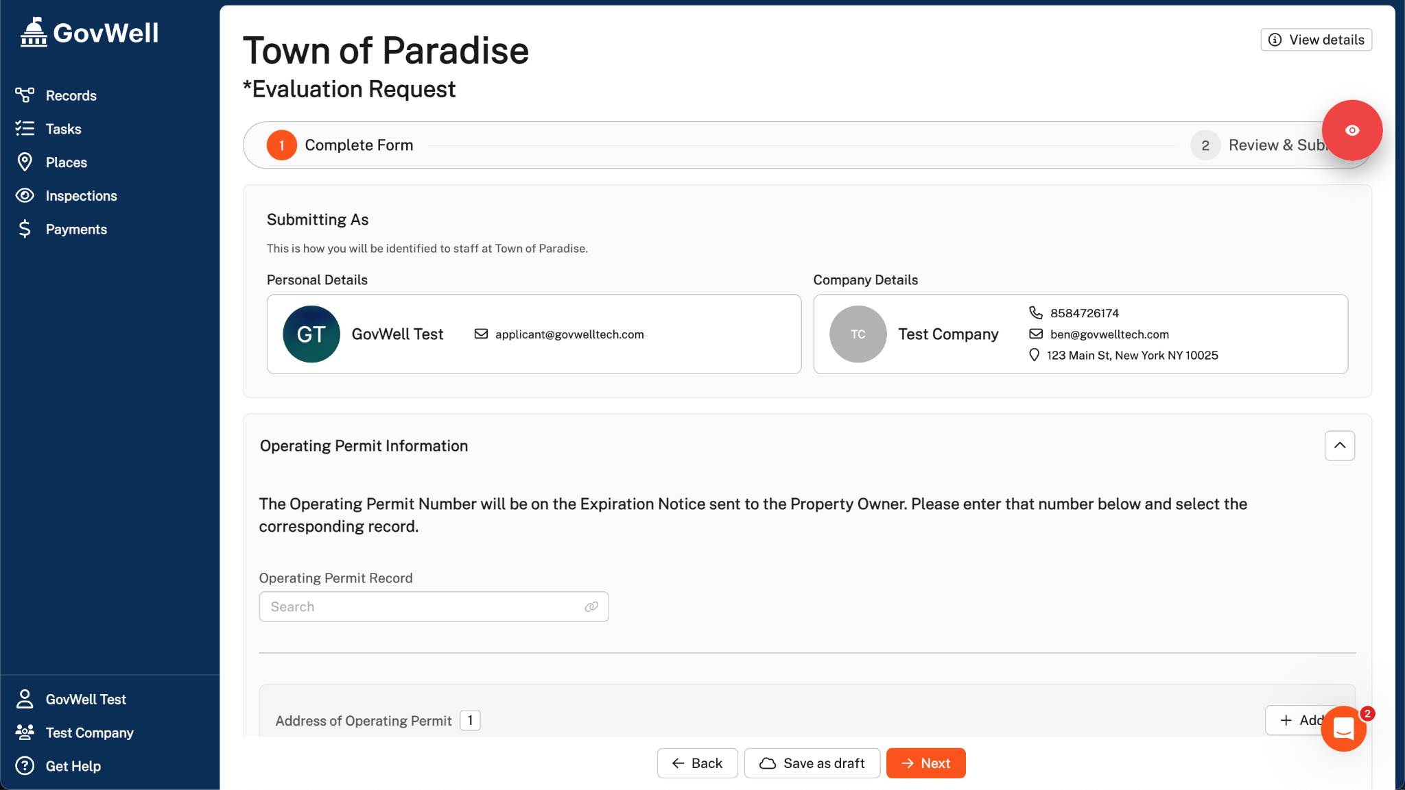
Fill Out the Evaluation Request
Once you select Evaluation Request, you will be brought to the Evaluation Request Application

Slide 12
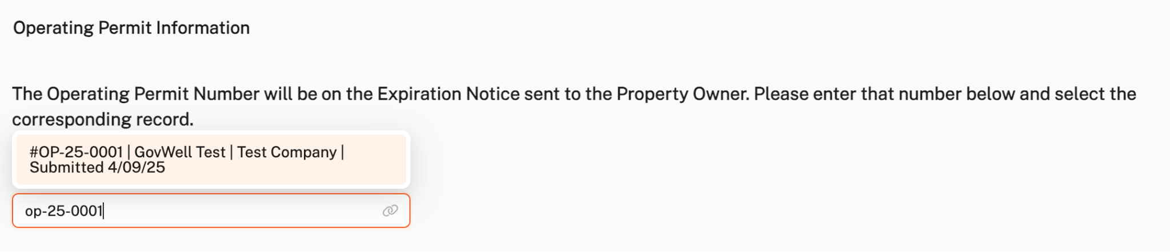
Associate the Relevant Operating Permit
You will associate the Operating Permit that this Evaluation is for on the application. You can search by address or Operating Permit Number, which the Property Owner will receive on their Expiration Notice.
This will appear as a dropdown where you can select the correct operating permit.

Slide 13
Evaluation Request Application Includes:
Operating Permit Number (not required)
Property Address
Your Evaluator Record Number

Slide 14
Submit an Evaluation
for an Operating Permit

Slide 15
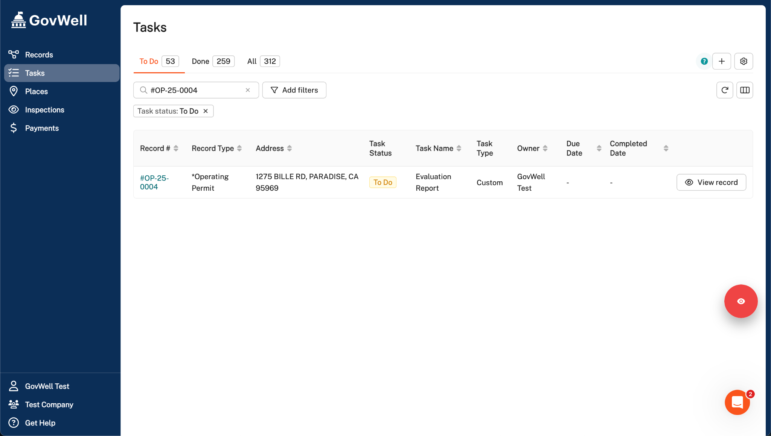
Submit an Evaluation Report
Once your Evaluation Request has been completed, you will be assigned an Evaluation Report task
You can click into that record to complete the Evaluation Report

Slide 16
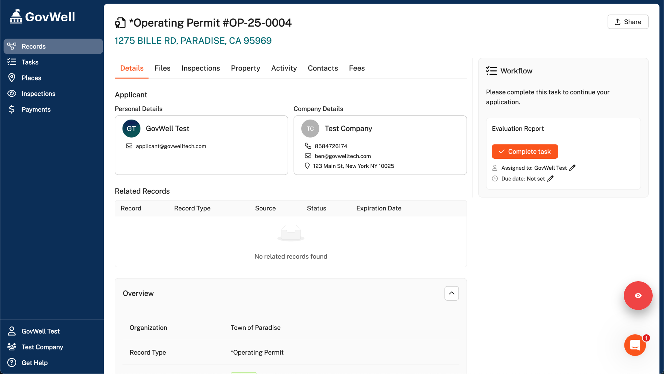
Submit an Evaluation Report
Once in the Operating Permit record, click the orange “Complete Task” button to begin the Evaluation Report

Slide 17
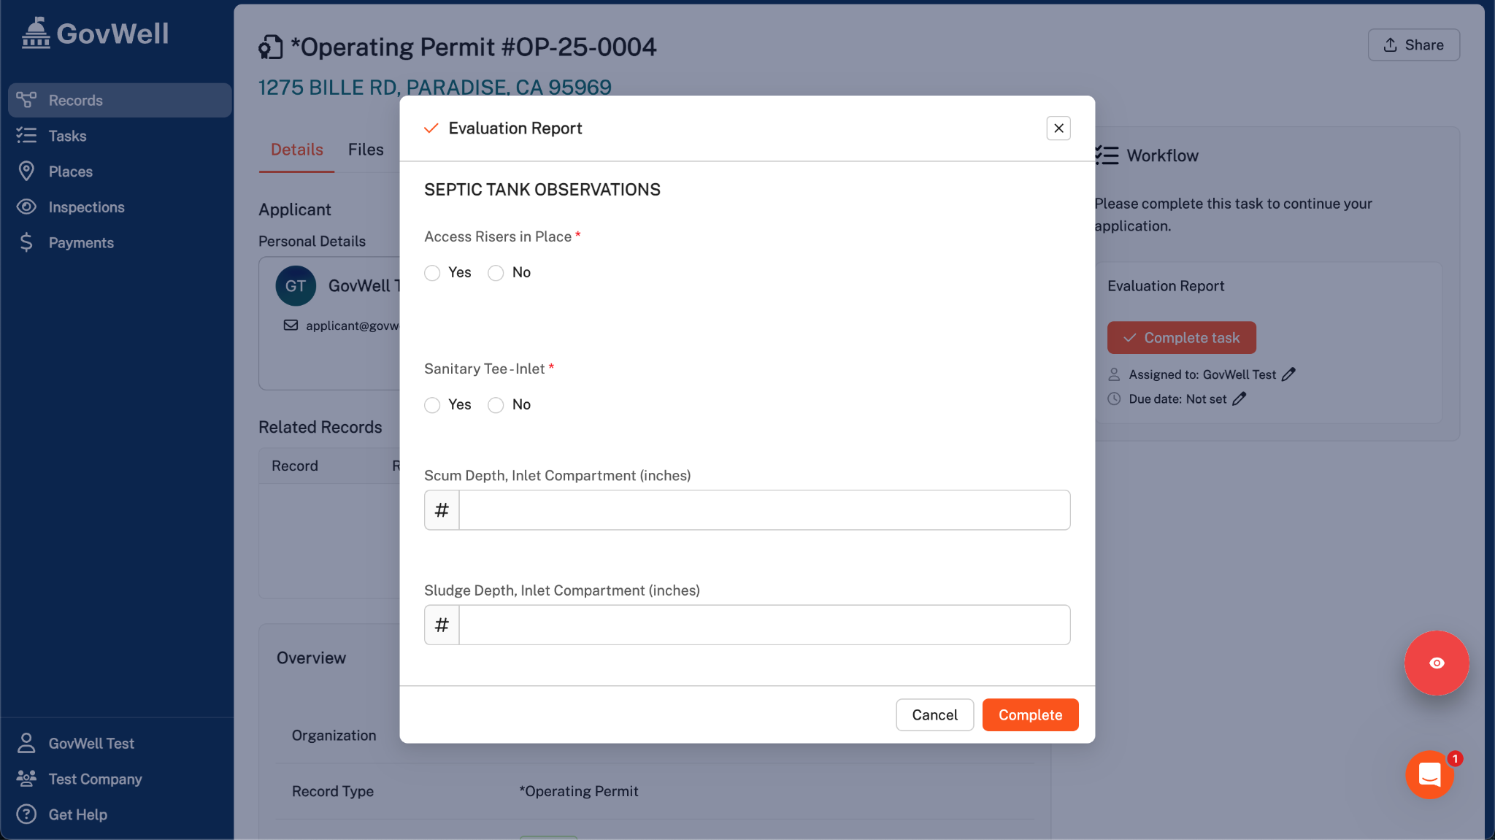
Submit an Evaluation Report
Once you click complete task, you will be able to fill in your Evaluation Report and Submit!

Slide 18
GovWell Support

Slide 19
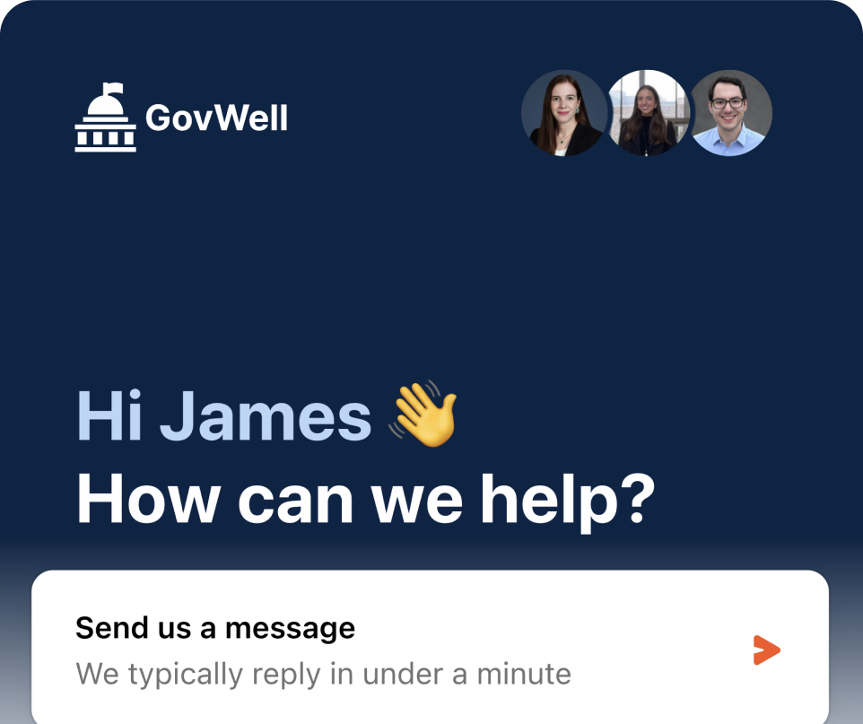



GovWell Offers Chat Support
Reach out to our live Support Team if you need assistance!
1 minute response time
Contact us via chat, phone, and email
We answer citizen questions for you
Reduce phone calls & emails to your office
Joe Smith - Contractor
How do I pull a new building permit?
Zach - GovWell
Hi, this is Zach from GovWell. I can help you start your application. Please follow the link below for a new building permit application.
govwelltech.com/gotham-city/building
Joe Smith - Contractor
Thanks, I appreciate it!

