Slide 1
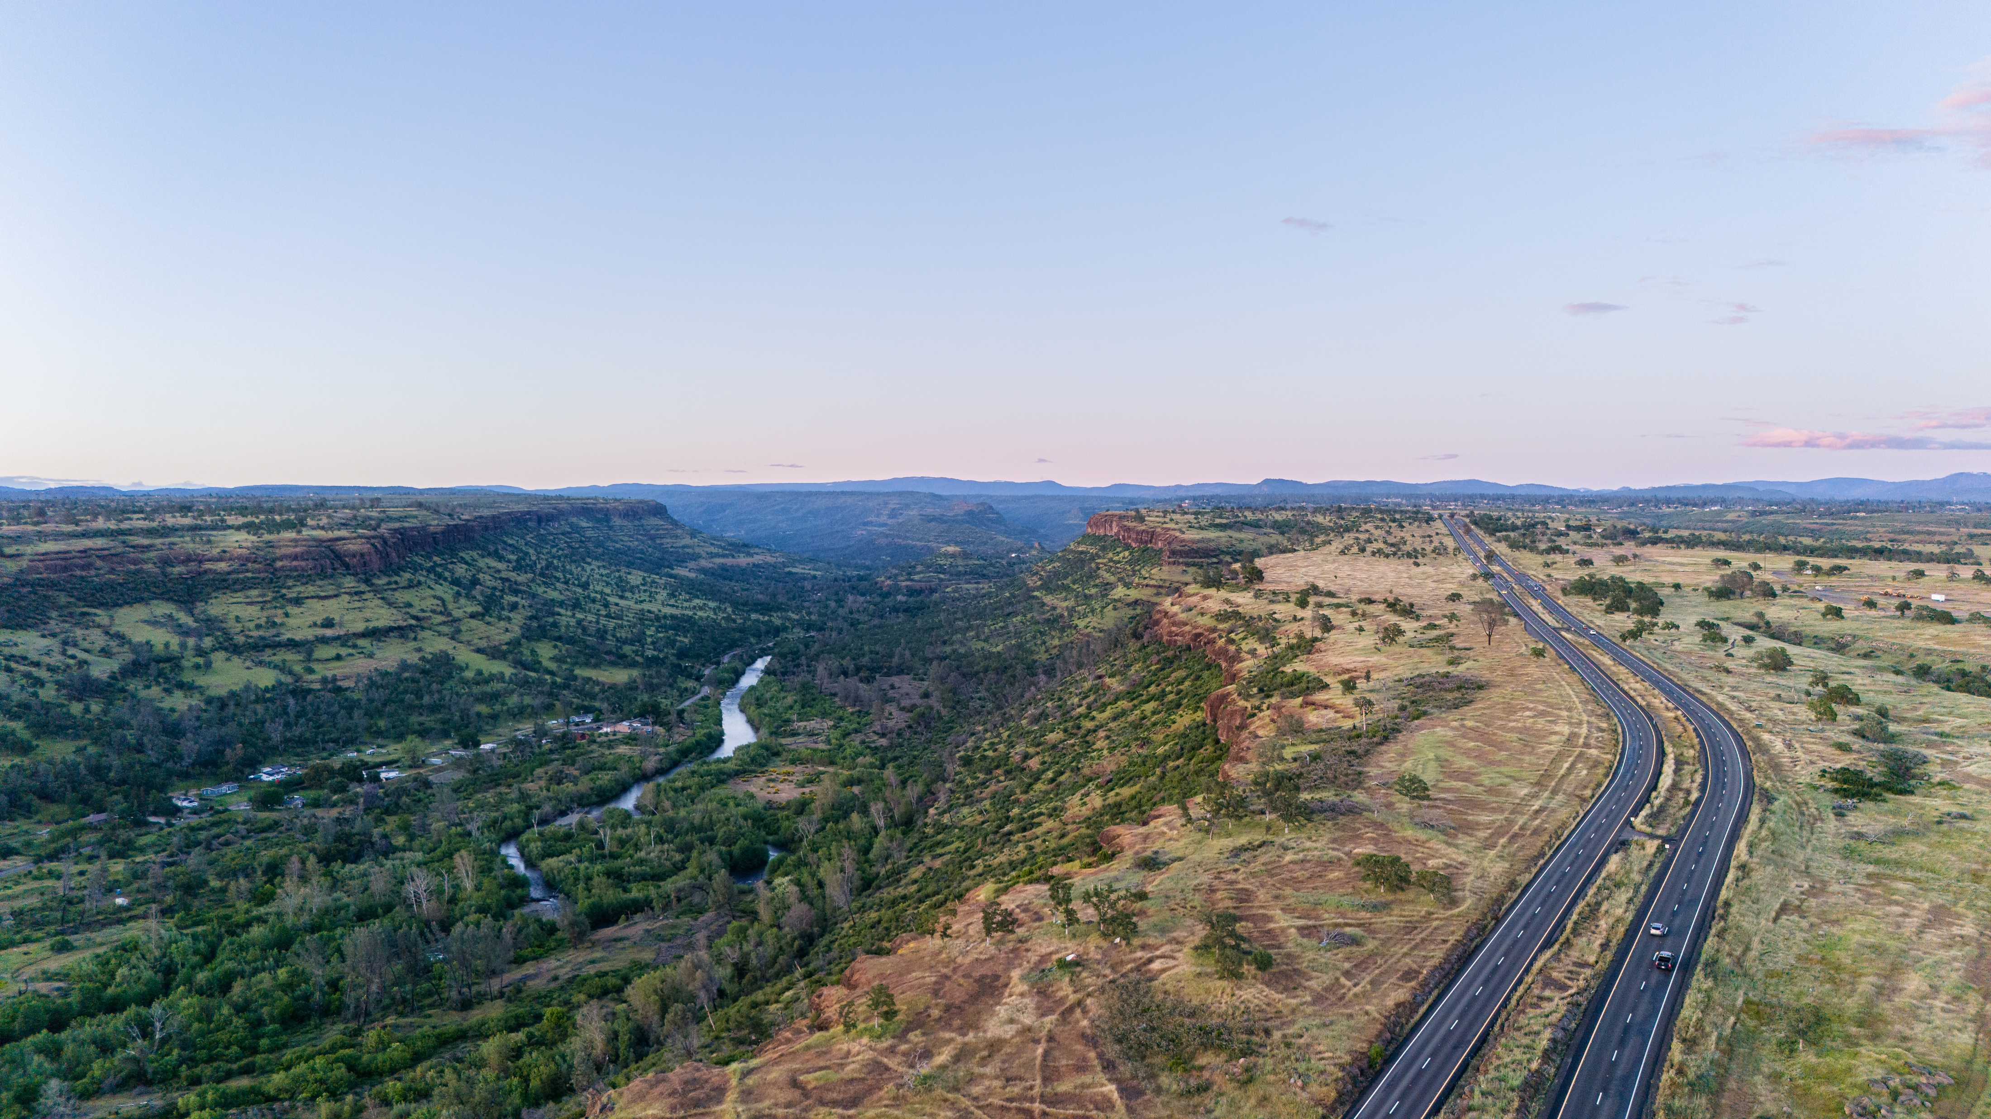
Welcome to the Ridge
Annual Update
8/12/25

Slide 2
Budget Breakdown
Total budget spend: $54,268
TOT contribution: $45,000
$38,085 spent on advertising services
Remainder spent on staff time
Variety of activities performed reaching various audiences

Slide 3
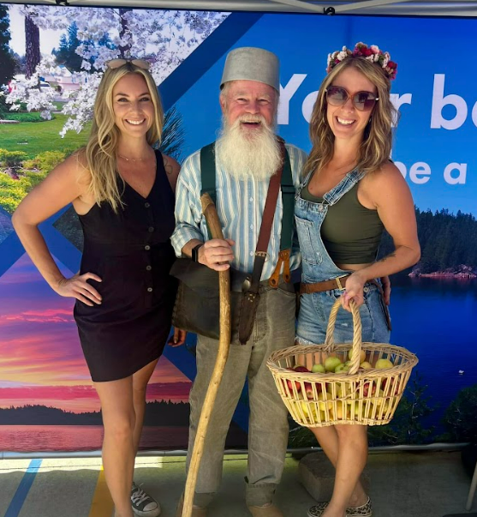
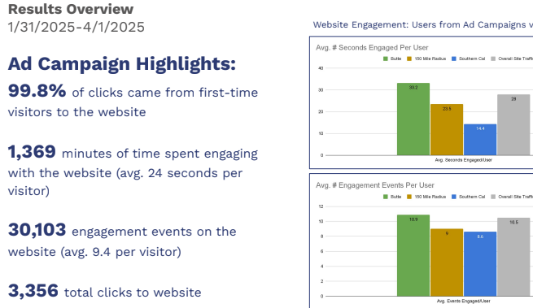
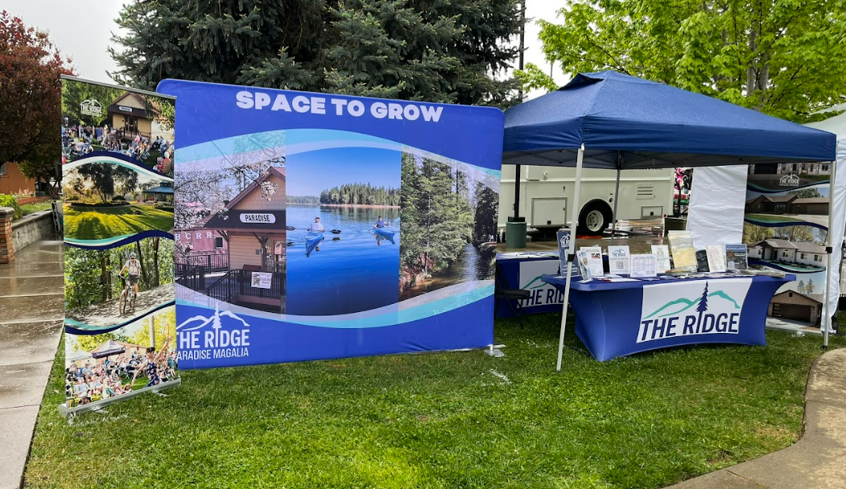
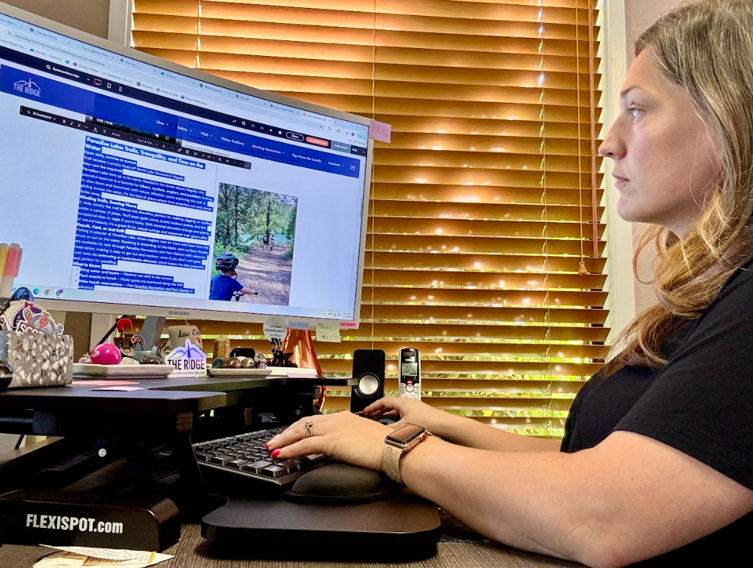
2024/25 Timeline of Activity
2/25: Ran 8 week paid search campaign with goal to drive traffic to WTTR website
5/25: Reviewed proposals for year-long WTTR marketing campaign. Selected Chartwell Agency and began onboarding
9/24: Advertising for Ridge Showcase at Johnny Appleseed Days
12/24: Engaged with C G Denero Consulting
4/25: Booth at Gold Nugget Days
6/25: Booth at Grazing Festival
10/5-6/24: Ridge Showcase set up during Johnny Appleseed Days
1/25: Hired staff to manage website updates, content development and social media.
Re-engaged with Creative Digital Agency for paid search campaign

Slide 4
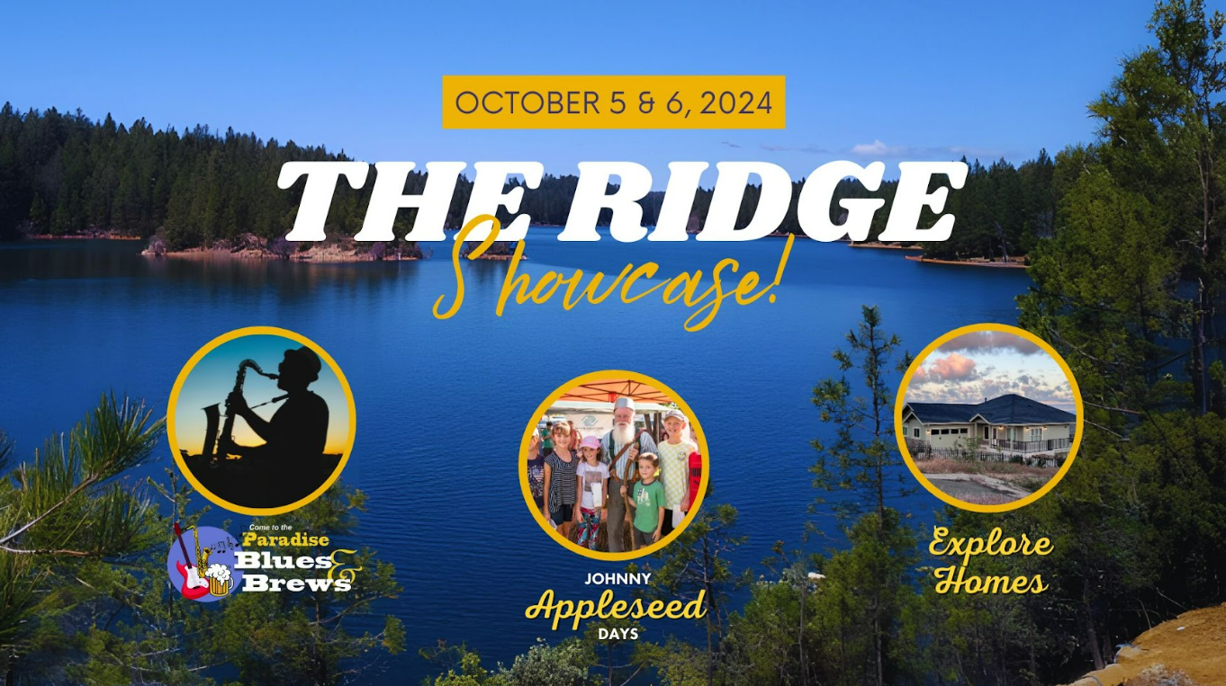

Slide 5
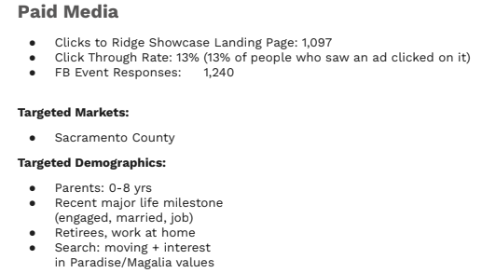
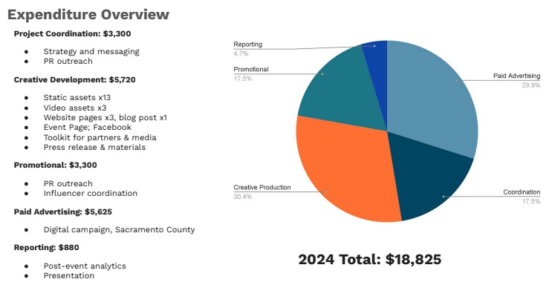
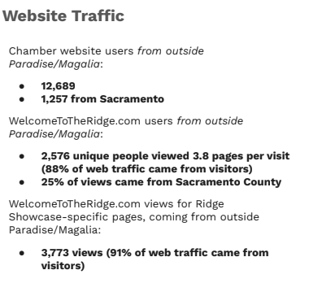
The Ridge Showcase Report

Slide 6
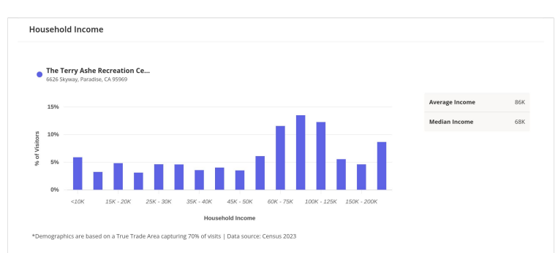
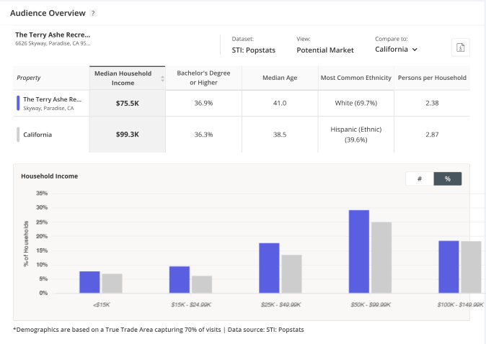
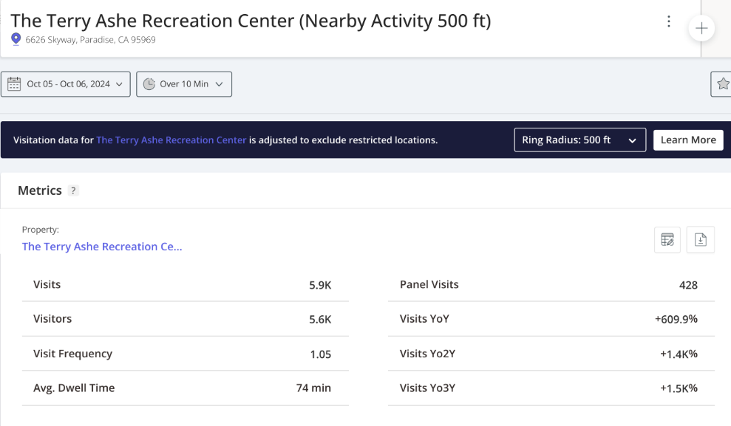
Placer AI Data for
Johnny Appleseed Days

Slide 7
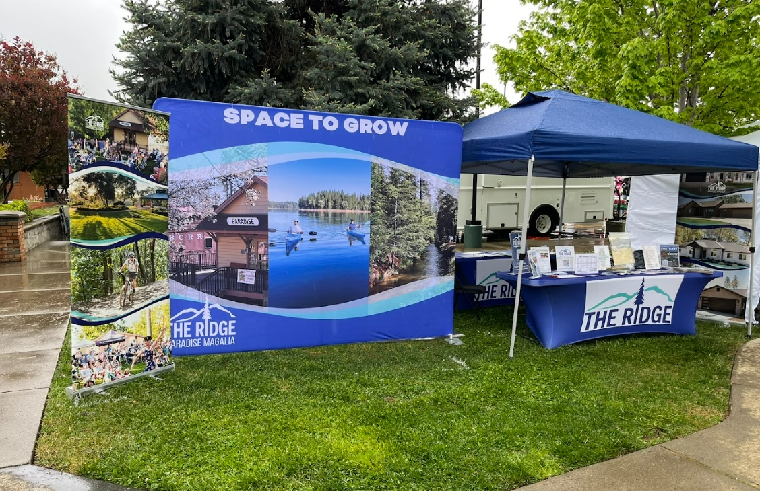
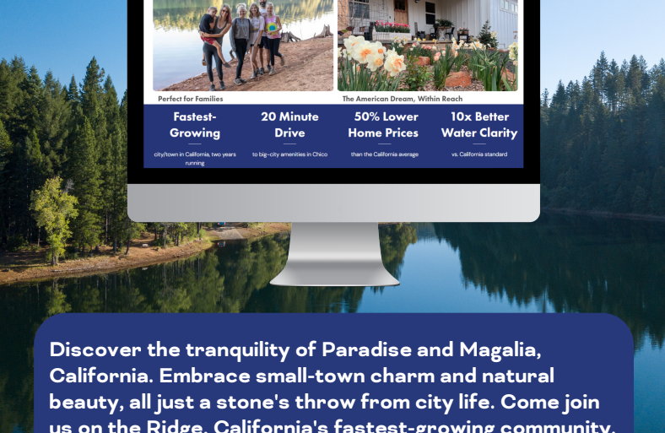
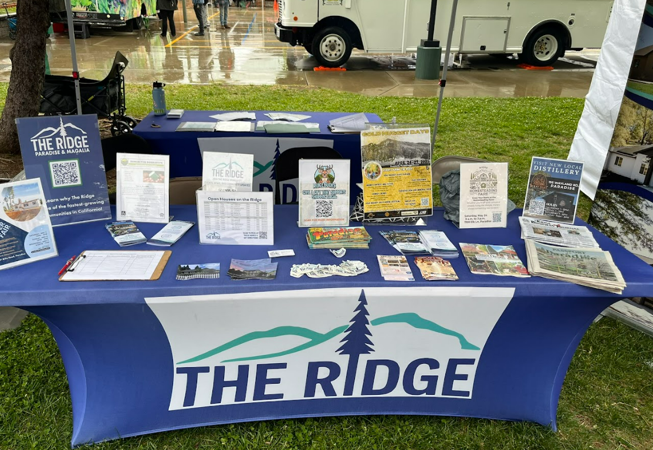
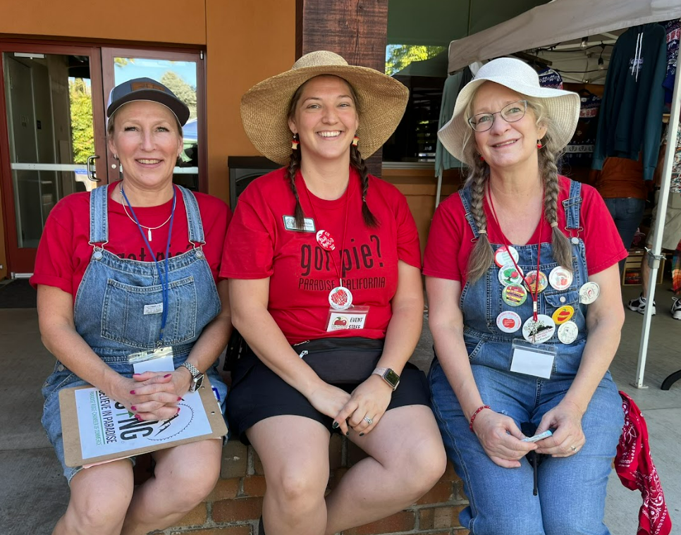


Slide 8
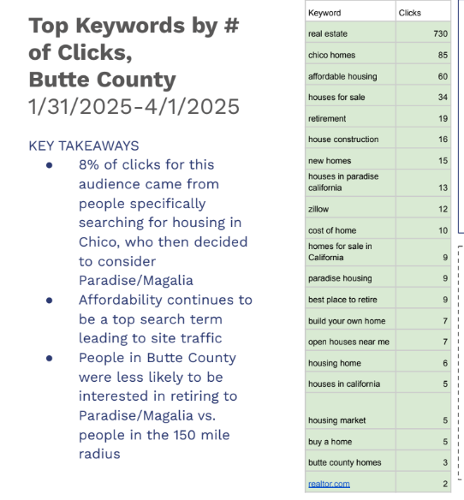
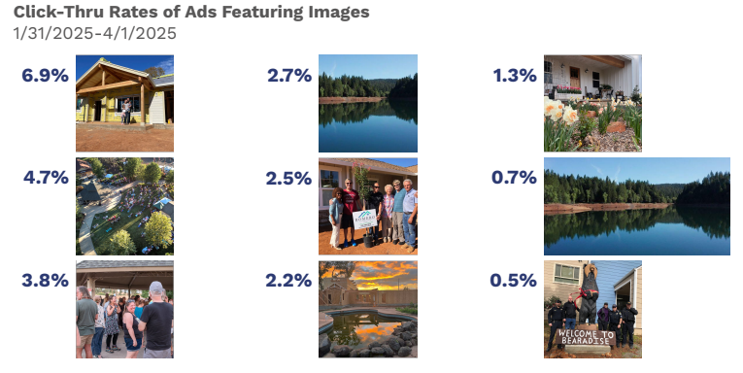
Paid Search Campaign – Goal: Drive Traffic to WTTR Website

Slide 9
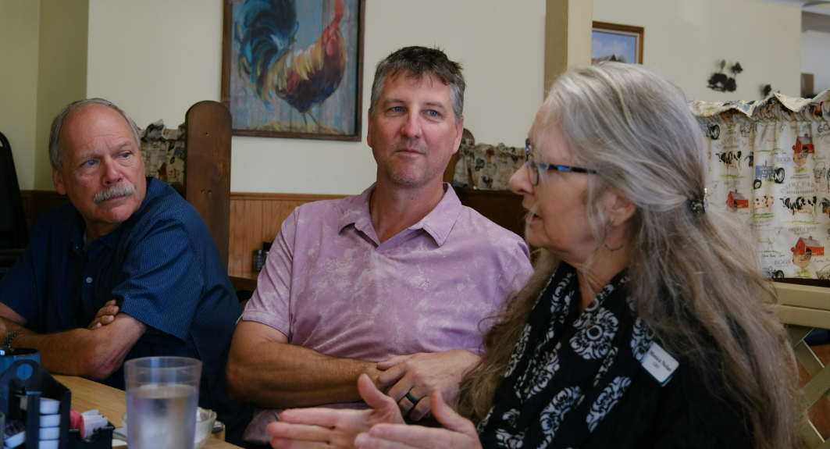
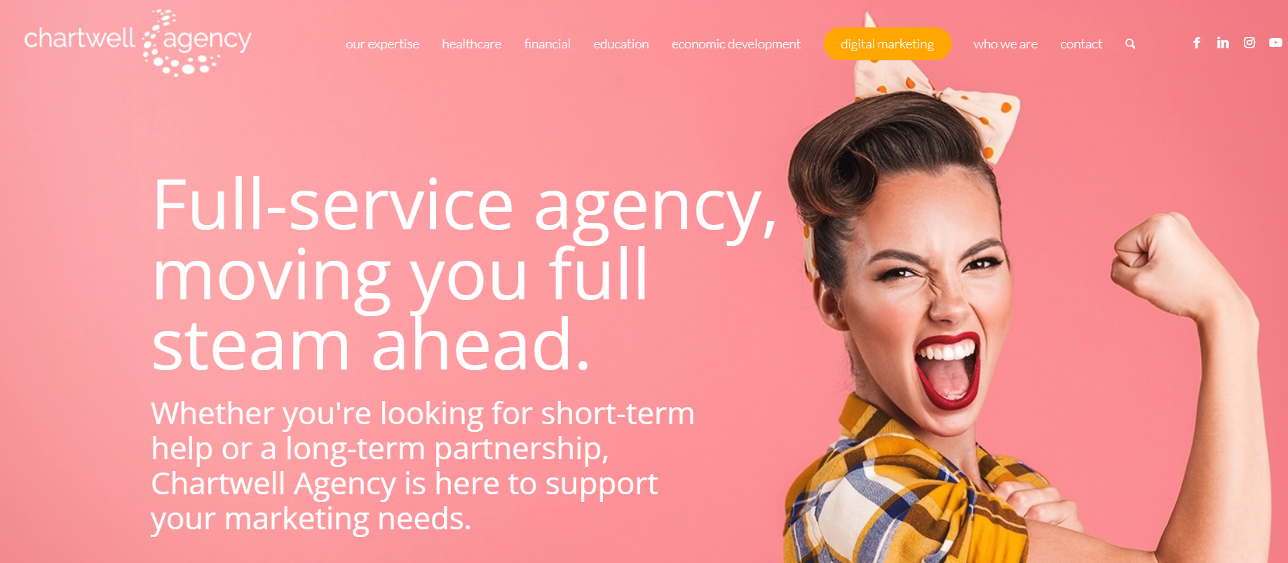
Plans for coming year
Work with Chartwell Agency to create and deploy an always-on paid media strategy to inspire people to visit Paradise and share with them the reasons they should choose to live here.
Will see significant increase in web traffic
Increase social media followers and influence
See more positive stories in the press through PR efforts
Consistent messaging for increased brand/Town recognition

Slide 10

Opportunity:
The Lost Bus
Action Items
Talking points to be used for Chamber, Town, any other partners
Create a real-time video to be hosted on WTTR website and show the community now
Pro-active press release
Toolkit for community members who may want to share their sentiments as the spotlight shines back on Paradise

Slide 11
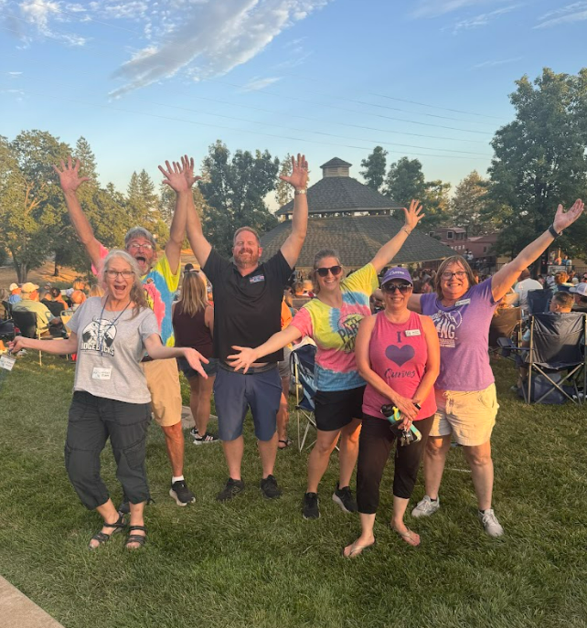

Questions?

