Slide 1

Zoning & Livestock Amendments
Town Council Presentation
August 12, 2025

Slide 2

Current status of livestock regulations
Discussion at the March 11th Council meeting about fire risk management strategies including zoning amendments pertaining to the keeping of livestock and grazing animals.
Direction to staff was given to draft zoning and animal regulation amendments for Council consideration that would allow the keeping of livestock on AR-3 & AR-5 zoned properties without a primary residence and potentially allow ag buildings in those zones.
Draft ordinance amendments were reviewed by Town Council on May 13th and conceptually approved to move forward for formal review and adoption.
Planning Commission reviewed and made a recommendation for approval, with some concerns voiced, at their June 17th meeting.

Slide 3

ZONING/LIVESTOCK REGULATIONS
Existing:
Zoning | Livestock Keeping | Ag Buildings | Primary Residence
AR-3 | Permitted by right | Not permitted | Required
AR-5 | Permitted by right | Not permitted | Required
Proposed (for vacant properties):
Zoning | Livestock Keeping | Ag Buildings | Primary Residence
AR-3 | Administrative Permit | Permitted with Use Permit | Not required
AR-5 | Administrative Permit | Permitted with Use Permit | Not required

Slide 4
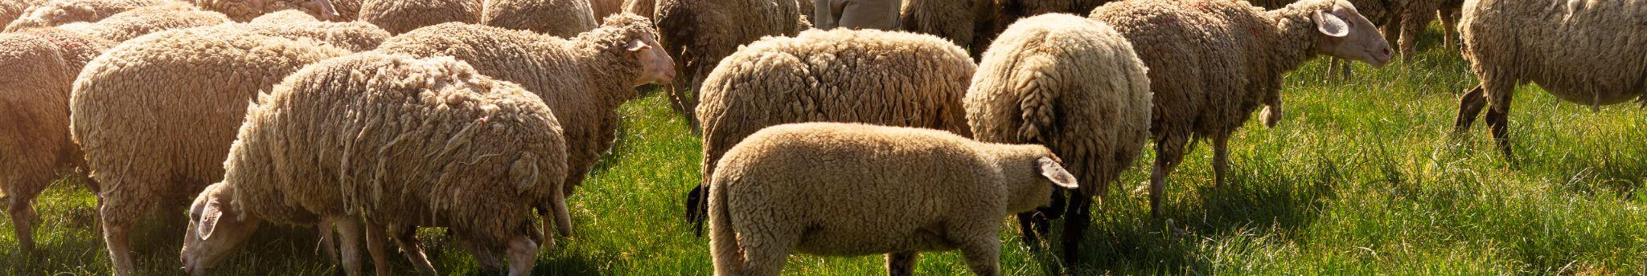
ADDITIONAL AMENDMENTS
Amend the definition of “private stables” to allow for the boarding of all livestock instead of only horses (permitted-by-right).
Require an Animal Management Plan to address minimum standards such as:
  Fencing
  Shelter
  Manure/waste management
  Feeding & watering
  Allow adjoining vacant parcels to be utlitized, without an Admin Permit, if the owner lives next door (added at May 13th Town Council meeting).

Slide 5
What does all of this mean?
Administrative Permit
Primary Residence
Adjoining Property
7 of the 9 residential zones already require Admin Permits for livestock, this amendment would also require the AR-3 & AR-5 to secure an Admin Permit (when there is no residence on-site).
All 9 of the residential zones require a primary residence be established in order to have livestock. This amendment would allow the AR-3 & AR-5 to have livestock without a house.
Living on an adjoining property would constitute having a residence “on-site” in the AR-3 & AR-5 zones and continue to allow livestock by right.
Ag Buildings
Private Stables
Animal Management Plan
Ag buildings are not currently permitted in any residential zone. This amendment would potentially allow ag buildings in the AR-3 & AR-5 zones without a residence.
Amend the definition of private stables to allow all livestock and not just horses. Would continue to be permitted-by-right (but still subject to a building permit) in the AR-3 & AR-5 zones.
Require applicants prepare an animal management plan that can be used as enforceable conditions for the Admin Permits. Plans will also be reviewed by Animal Control.

Slide 6
Cost of Compliance
Varies
$ Varies
Building permits for stables and ag buildings will vary based on size and construction type – design will also dictate whether an engineer/ architect is required, but surveys are still required
$880.34
$880.34
Conditional Use Permit for an ag building as a primary use (without a residence) – can cover both the ag building AND livestock under one Use Permit if submitted concurrently
$352.14
$352.14
Administrative Permit (one-time fee) for livestock when there is not a house on-site or if the owner does not reside next door

Slide 7
Council Action Requested
Conduct Public Hearing
Introduce Town Ordinance No. 648 “An Ordinance Amending Text Regulations within Paradise Municipal Code Title 17 of the Paradise Municipal Code Relative to the Agricultural Residential Zoning District; General Definitions; and the Animal Regulations”

Slide 8
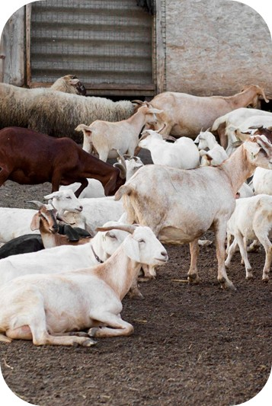
Questions?

