Slide 1

Capital Projects & Right of Way
Paradise Town COUNCIL MEETING
AUGUST 12, 2025

Slide 2
Capital Projects in Disaster Recovery
Community Priorities
Project Scoping
Project Design & Implementation

Slide 3
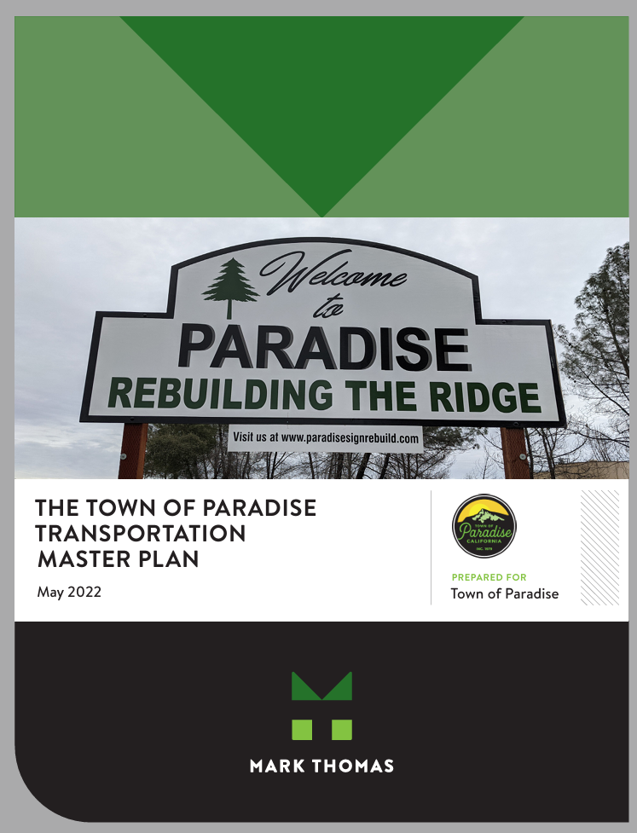
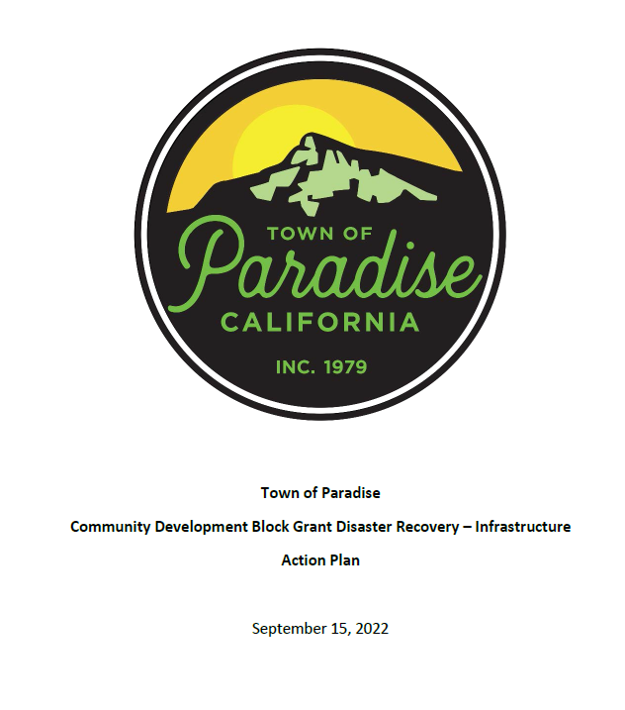
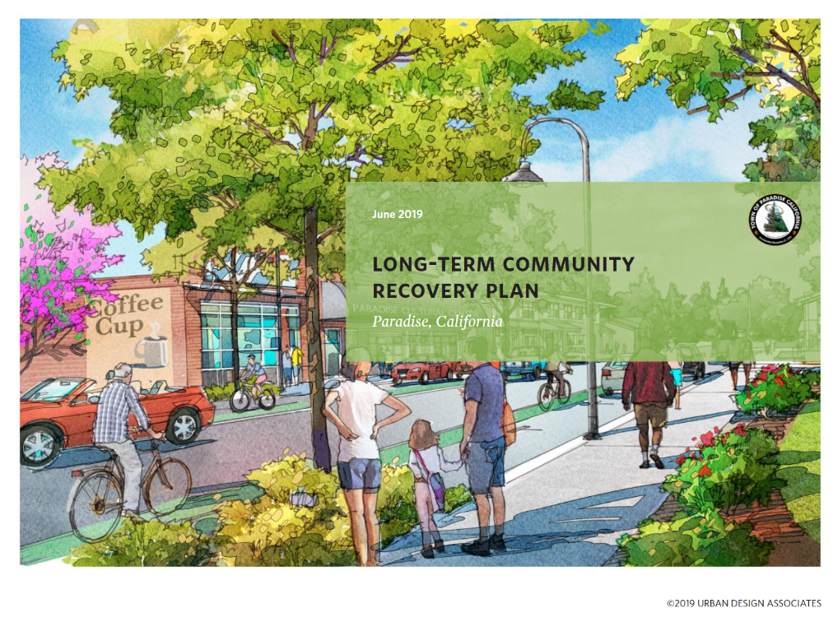
Capital Projects in Disaster Recovery

Slide 4
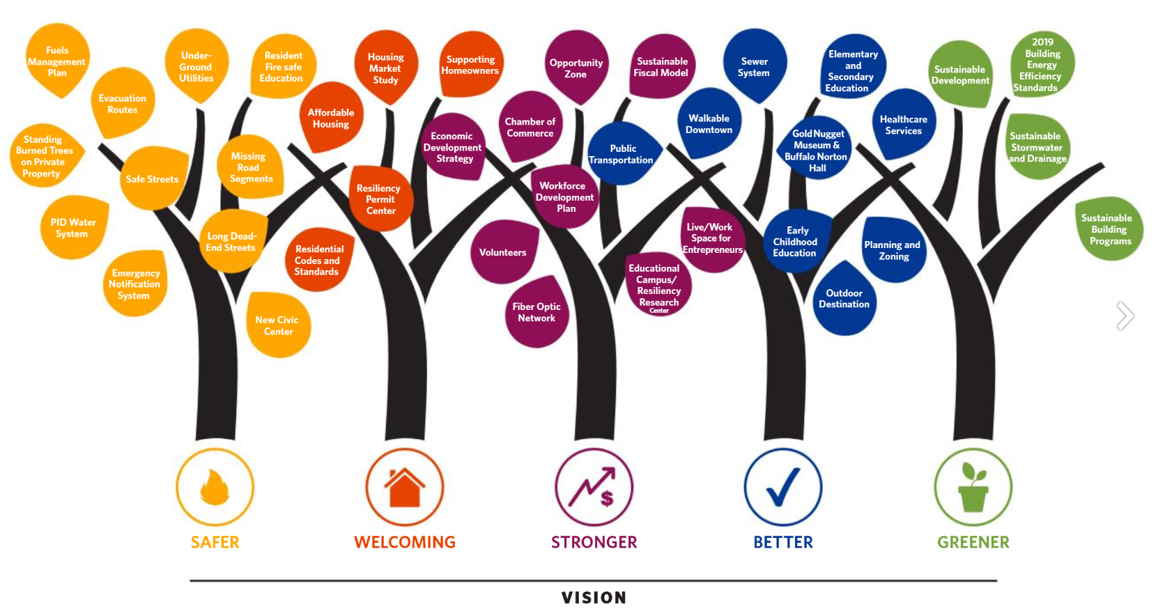
Long Term Recovery Plan

Slide 5
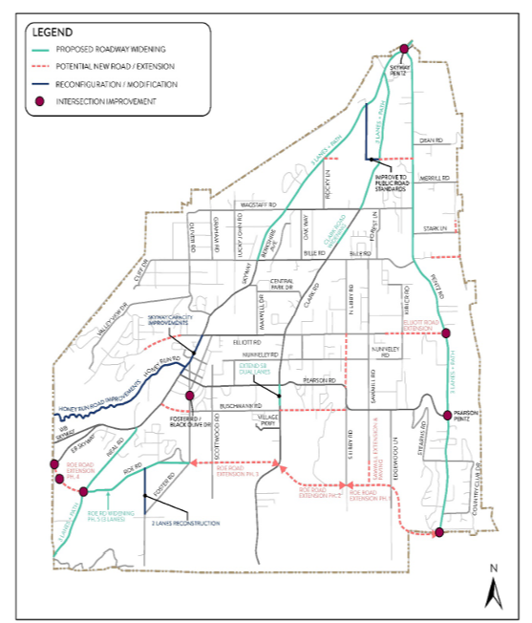
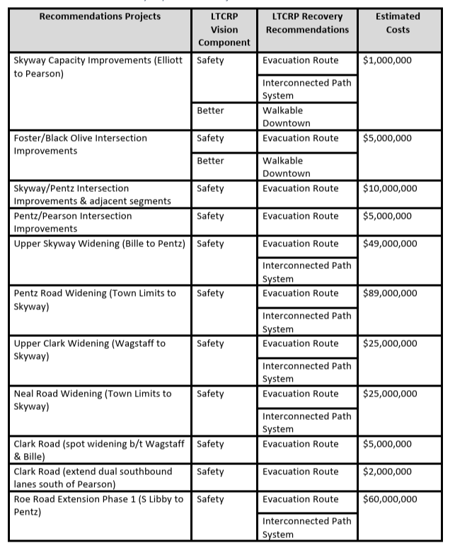
Transportation Master Plan

Slide 6
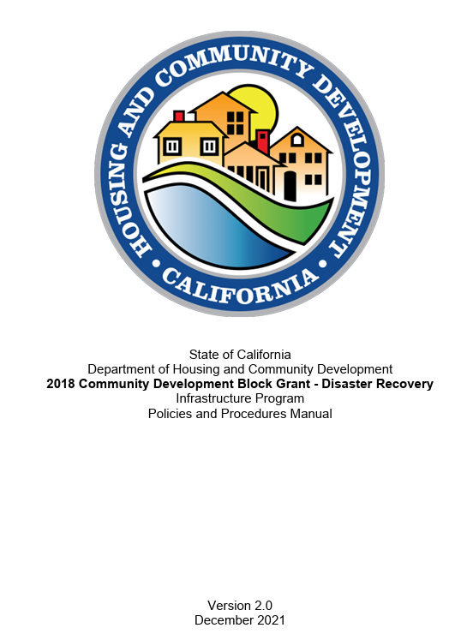
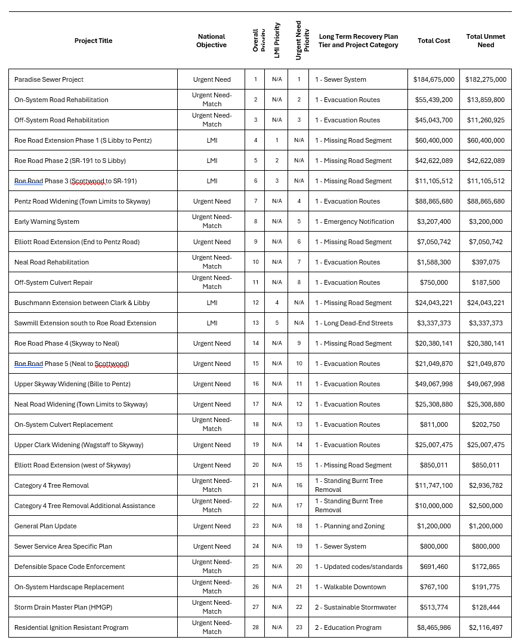
CDBG-DR Infrastructure Funding
Months to submit Notice of Intent for projects meeting eligibility criteria
Town submitted 60 projects valued over $900M
Council adopted prioritized list February 2022
$317M Available
$199M Secured

Slide 7
CDBG-DR Action Plan History
September 2022 – Paradise Town Council adopts original Action Plan
December 2022 – Paradise Town Council adopts Action Plan Amendment 1 (APA-1), adding additional projects through the Town’s Active Transportation Program Cycle 6 awards
January 2024 – Paradise Town Council adopts Action Plan Amendment 2 (APA-2), supplementing budgets and accounting for new grant awards
April 2025 - Paradise Town Council adopts Action Plan Amendment 3 (APA-2), supplementing budgets and accounting for increased project costs

Slide 8

Project Development Process
Environmental
Right of Way
Construction
Design
Concept
Council Checkpoints

Slide 9
Key Items of Work between Concept & Design
Survey
Field Survey & Mapping
Right of Way Mapping
Environmental
Initial Scoping
CEQA
Geotechnical
Laboratory Testing
Draft Report
NEPA
Coring & Sampling
Utility Coordination
“A” Letters
“B” Letters
Preliminary Design
Drainage Analysis
35% PS&E
Preliminary Right of Way
Roadway Design
ROW Assessment
Title Reports
Owner Exhibits
Final Design
Survey
Permitting
Geotechnical
Utility Relocation Plan
65% PS&E
95%/100% PS&E
Final Right of Way

Slide 10
Key Items of Work between Concept & Design
Survey
Field Survey & Mapping
Right of Way Mapping
Environmental
Initial Scoping
CEQA
Geotechnical
Laboratory Testing
Draft Report
NEPA
Coring & Sampling
Utility Coordination
“A” Letters
“B” Letters
Preliminary Design
Drainage Analysis
35% PS&E
Preliminary Right of Way
Roadway Design
ROW Assessment
Title Reports
Owner Exhibits
Final Design
Survey
Permitting
Geotechnical
Utility Relocation Plan
65% PS&E
95%/100% PS&E
Final Right of Way

Slide 11
What is Right of Way?
Right of Way (ROW) – A Right of Way is the permission—often legally recorded—that allows the Town to use a portion of private or public land for community improvements such as roads, sidewalks, utilities, or evacuation routes.

Slide 12
What are the different types of ROW?
1. Permit to Enter (PTE)
A short-term written agreement that allows the Town or its contractors to go onto private property for specific work, such as surveys, environmental studies, or early construction activities. This permission is temporary and does not transfer any ongoing rights or ownership.

Slide 13
What are the different types of ROW?
2. Temporary Construction Easement (TCE)
A limited right to use a portion of private property for a set period of time during construction—often for equipment access, staging materials, or grading work. Once the project is complete, the Town’s right to use the space ends, and the property is returned to the owner in agreed-upon condition.

Slide 14
What are the different types of ROW?
3. Permanent Easement
A lasting legal right for the Town to use a defined area of private property for a specific public purpose—such as maintaining a road, utility line, drainage facility, or evacuation route. The property remains under the owner’s title, but the Town retains the right to access and maintain the easement area indefinitely.

Slide 15
What are the different types of ROW?
3. Permanent Acquisition in Fee
The purchase of full ownership rights to a portion of a property. In a permanent fee acquisition, the public agency becomes the legal owner of the acquired land, and the previous owner no longer retains any property rights to that area. This type of acquisition is used when the public project requires permanent use of the land, such as for a roadway, pathway, or other public facility.

Slide 16
How is Right of Way Paid for?
Within the Town’s Capital Improvement Program, approximately $20.5M is forecasted to be expended under 12 projects over the next three years.
At this time, all Right of Way needs are projected to be 100% reimbursable through respective grants funding each project.

Slide 17

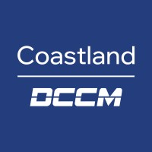

What is the Scale of Town ROW Needs?
Project Area: Pentz Road between Pearson Road and Skyway
Scope: Class I Multi-Use Bike/Ped Pathway, center-two way left turn lane widening, roadway rehabilitation, traffic signal
Project Area: Skyway between Bille Road and Wagstaff Road
Scope: Class I Multi-Use Bike/Ped Pathway, center-two way left turn lane widening, sidewalks, roadway rehabilitation
Project Area: Roe Road Extension between Edgewood and Clark Road
Scope: New roadway, Class I Multi-Use Bike/Ped Pathway
Project Area: Neal Road between Town Limits and Skyway
Scope: Class I Multi-Use Bike/Ped Pathway

Slide 18
Is the Town “Taking” Properties?
Absolutely not. The Town’s priority is to work in partnership with property owners to secure the right-of-way needed for infrastructure improvements in a way that is respectful, transparent, and mutually beneficial. Our approach is centered on voluntary acquisitions to the maximum extent practicable, ensuring that property owners are fully informed and receive fair market compensation determined by an independent, professional appraisal process.
The majority of Right of Way needs are forecasted to be minor property frontages to accommodate minimal road infrastructure widening.

Slide 19
What is Eminent Domain?
A legal process that allows a public agency to acquire a portion of private property for a public use when an agreement with the owner cannot be reached. It is not the Town’s first or preferred approach and would only be considered with Town Council approval, after all voluntary options have been fully explored, and in compliance with all legal and funding requirements.
In some rare cases, Eminent Domain is the only alternative for legal acquisition – even with a willing partner
Our goal is simple: deliver the resilient infrastructure our community needs while preserving the trust, respect and the sensitivity of our recovery from the 2018 Camp Fire. No entire property or home displacements – ever.

Slide 20
Who Administers ROW for the Town?
Implementing ROW activities requires many services which cannot be performed by Town staff.
Council has already awarded contracts for projects which build in ROW support
  Dokken Engineering
  Jacobs
  Coastland Engineering
Consultants also rely on independent appraisers, title companies and other services as needed

Slide 21

What is the Town’s Vision for ROW and the Partnership with the Public?

Slide 22
What is the Town’s Vision for ROW and the Partnership with the Public?

Slide 23
The ParadiseWORKS Land Coordination Team is committed to building trusting, respectful, and voluntary partnerships with property owners whose land may be needed to support the Town’s Capital Improvement Projects. We believe that resilient infrastructure is best achieved when it is planned and built with the community, not just for it.
Our approach centers on open communication, clear information, and good-faith collaboration. Every interaction will be grounded in transparency, fairness, and a sincere respect for private property rights. We will work side-by-side with residents to identify mutually beneficial solutions, ensure full understanding of the process, and honor the principle that all acquisitions under this program are aimed to be voluntary.
Through these partnerships, we aim to deliver the infrastructure Paradise needs while preserving the trust, dignity, and shared vision of the community we serve.

Slide 24
The Right of Way Process
Jamie Formico, SR/WA, R/W- NAC, R/W-RAC
DRE# 01445531
Right of Way Manager
Dokken Engineering

Slide 25
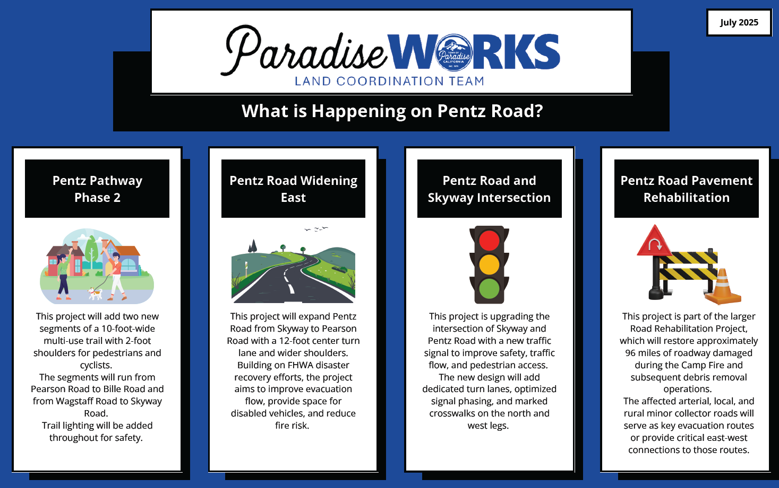
Step 1: Project Flyers
Our Right of Way team distributes project flyers to all affected property owners.
Each flyer includes:
  A brief overview of the project and its location
  Information on the anticipated timeline for each project phase
  Contact details so owners can reach out with any questions

Slide 26
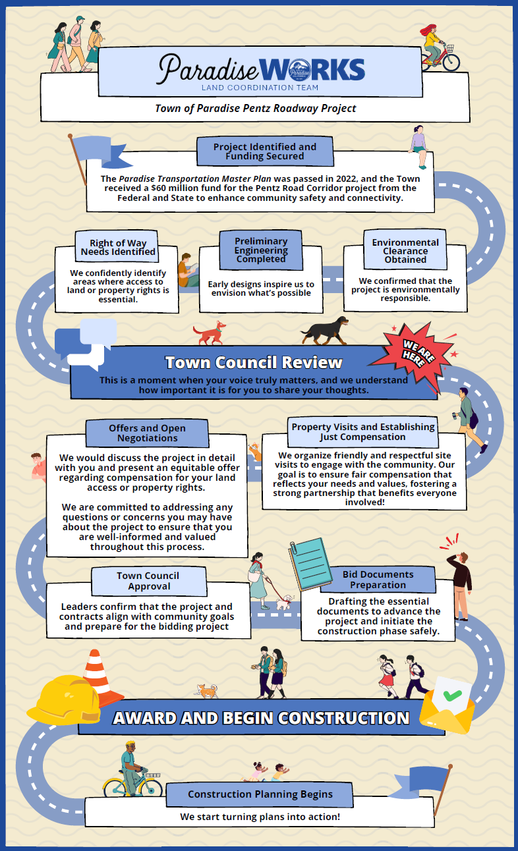
Step 2: Appraisals and Valuations
An appraisal or valuation is conducted for properties potentially affected by a public project. Licensed professionals will assess the market value of the property through these reports. Owners will be notified in advance about the inspection and invited to attend.
During the inspection, both the appraiser and the right of way agent will be present. The right of way agent will explain the appraisal process, discuss how the project may impact the property, and document any relevant information shared by the owner.

Slide 27
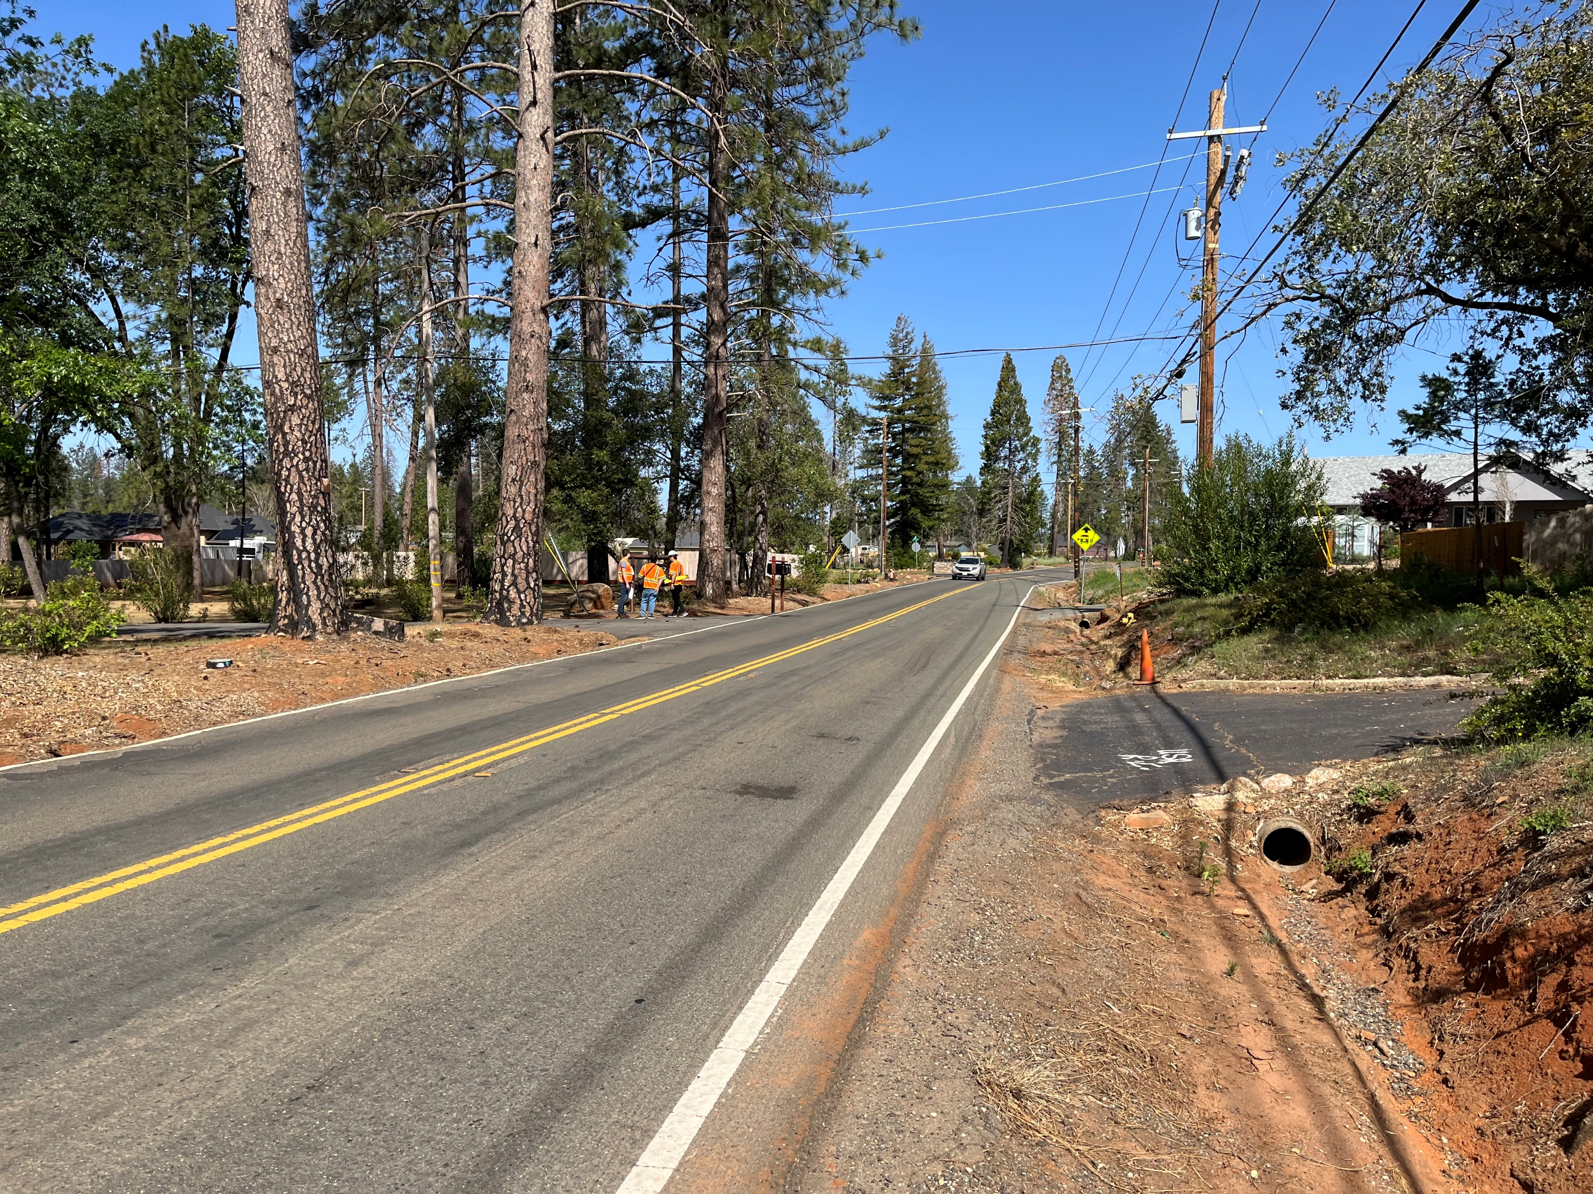
Step 3: Property Owner Meetings
Once valuations are complete, the right of way agent will arrange an in-person meeting to present the offer package. Each package will clearly detail the required right of way, the basis for the offer, and include all supporting documentation in compliance with federal and state regulations. This offer package forms the basis for a transparent and fair negotiation process.

Slide 28
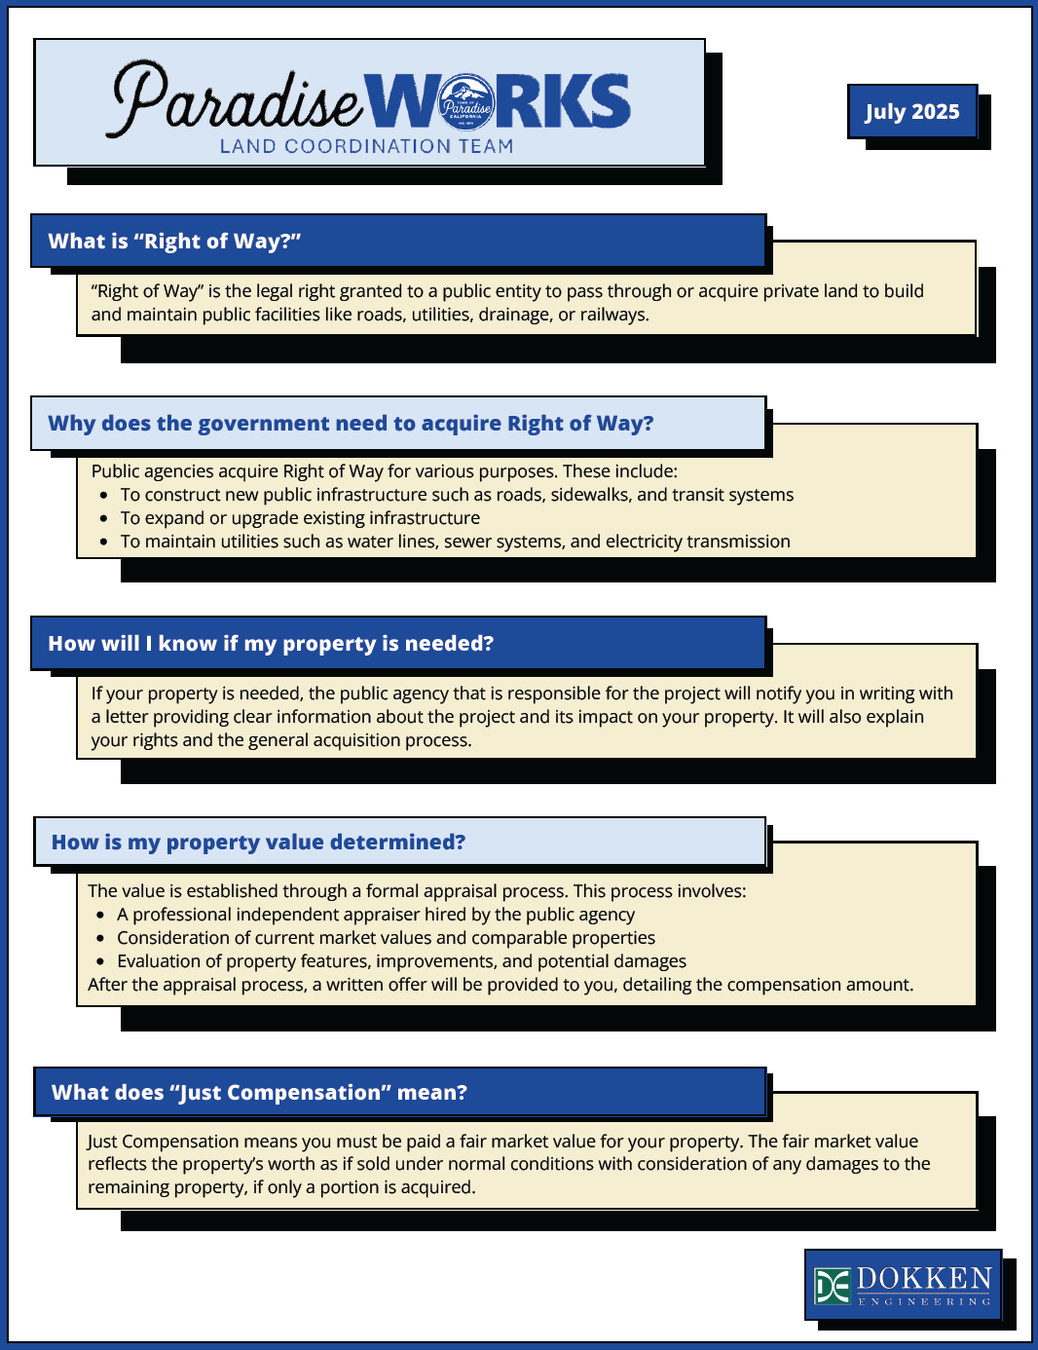
Step 4: Negotiations
Negotiations provide an opportunity for the owner and the right of way agent to address any additional concerns or questions regarding the project and the offer presented. The primary goal is to ensure that owners feel well-informed and valued throughout the Right of Way process.

Slide 29
Step 5: Title & Escrow
The right of way agent will review all items listed on the owner's title. If any items need to be removed, the right of way agent will assist the owner in completing the necessary steps to clear these from the title.
Once the owner has completed the right of way documents and the fully executed documents have been delivered to escrow, the escrow process will be initiated. Additional escrow documents are typically required for most transactions; the right of way agent will work closely with each owner to ensure these documents are completed as needed.

Slide 30
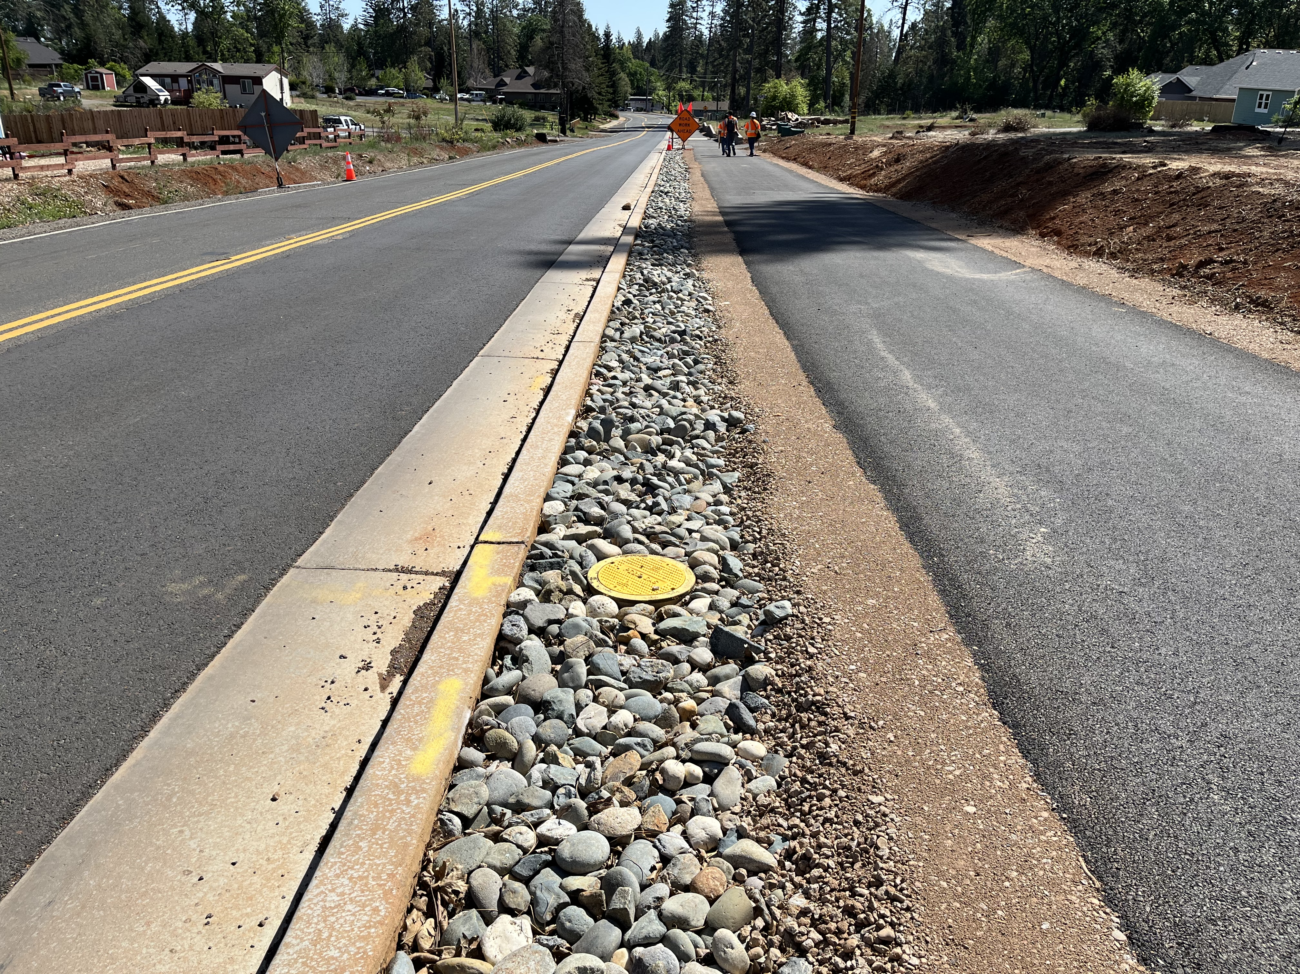
Step 6: Construction
The responsibilities of the right of way agent continue beyond the close of escrow.
All negotiated items, as well as those included in the initial offer to the owner, are thoroughly documented and shared with the design team to ensure they are incorporated into the construction of the project.
If the owner wishes to confirm any information related to their property during the construction phase, the right of way agent remains available to assist and discuss any concerns.

Slide 31
Next Steps
Projects will continue to advance through each phase, many of which will reach Right of Way phase work.
Council will be informed through Closed Session when contact is planned to be made to each property owner relating to Right of Way needs
Formal process will begin and further Council considerations will be made on a project-by-project and parcel-by-parcel basis.

Slide 32
Questions?

